Slide 1
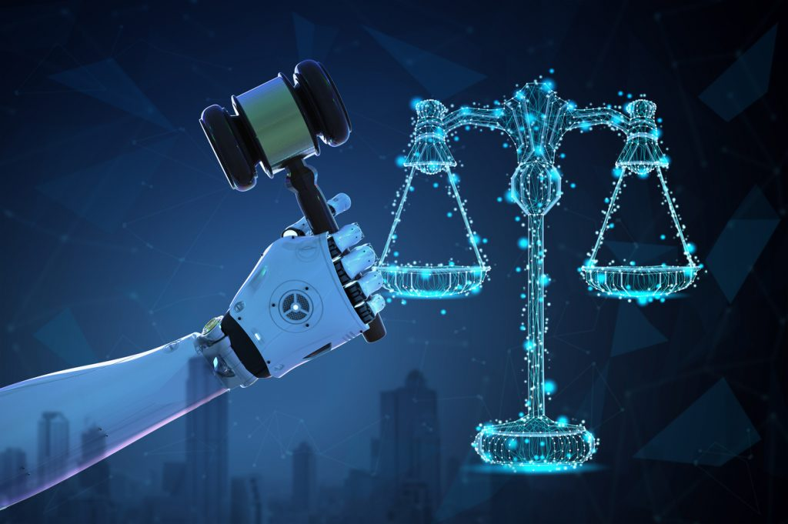
Employing Artificial Intelligence to Advance Patient Safety in Nigeria: Legal and Ethical Issues Arising
Dorcas a. AkinpelU (mrs.)
Simisola O. Akintola (Prof.)
Department of Private and Property Law, University of Ibadan, Nigeria

Slide 2
BACKGROUND/INTRODUCTION
Clinical risk predictions and diagnosis
Team Work
Early discovery of medical errors
Coordination
Adherence to existing safety protocols
Collaboration
Patient care monitoring
Communication

Slide 3
BACKGROUND/INTRODUCTION
AI is, in several ways, reconfiguring the boundaries of patients, patient safety, clinical practice, public/private domains etc.
These reconfigurations call for an appreciation of AI’s strengths, limitations, as well as legal and ethical complexities.

Slide 4
LEGAL AND ETHICAL ISSUES ARISING
Underrepresentation/Discrimination
Autonomy
Privacy and Confidentiality
Informed Consent
Assignment of Responsibility and Liability
Data Security

Slide 5
LEGAL AND ETHICAL ISSUES ARISING
Quality & Quantity of Data
Accuracy of Output
Flawed/Bias Data
Underrepresentation/Discrimination

Slide 6
LEGAL AND ETHICAL ISSUES ARISING
Confidentiality
Privacy
Data Security
Autonomy

Slide 7
LEGAL AND ETHICAL ISSUES ARISING
The Black Box Problem
Novelty of AI
Technical Sophistication
Informed Consent: Data subject and Patient

Slide 8
LEGAL AND ETHICAL ISSUES ARISING
Assignment of Responsibility and Liability
The Black Box Problem
The Problem of Many Hands
Medical Negligence/Malpractice
Vicarious Liability
Product Liability

Slide 9
LAW | Underrepresentation/Discrimination | Privacy and Confidentiality | Data Security | Autonomy | Informed Consent | Assignment of Responsibility and Liability
Constitution of the Federal Republic of Nigeria | Section 42 | Section 37 | Inferred from Section 37 | NIL | NIL | NIL
The National Health Act | Section 20 – emergency treatment | Section 26 - 28 | Section 29 | Inferred from Informed Consent | Section 23 – Patient Section 32 – Data Subject | NIL
The NAFDAC Act | NIL | NIL | NIL | NIL | NIL | Section 5
The Food, Drugs and Related Products (Registration, Etc) Act | NIL | NIL | NIL | NIL | NIL | Sections 1 & 4

Slide 10
LAW | Underrepresentation/Discrimination | Privacy and Confidentiality | Data Security | Autonomy | Informed Consent | Assignment of Responsibility and Liability
The Federal Competition and Consumer Protection Act, (FCCPA) 2018 | NIL | NIL | NIL | NIL | NIL | Section 17
The Standard Organization of Nigeria (SON) Act | NIL | NIL | NIL | NIL | NIL | Section 3
The Patients’ Bill of Rights | NIL | YES | YES | Inferred from Informed Consent | YES | NIL
The Nigerian Code of Medical Ethics | Rule 9 (G) - emergency treatment | Rule 9 (F) | NIL | NIL | Rule 19 | Sections 1 & 4

Slide 11
THE NIGERIA DATA PROTECTION REGULATION AND THE USE OF AI IN ADVANCING PATIENT SAFETY
The Nigeria Data Protection Regulation (NDPR) suggest a general set of guidelines for collection, storage and use of data.
However, Paragraph 2.1 of the NDPR Implementation Framework provides that the Regulation does not apply to the use of personal data in furtherance of public health thereby limiting its application.

Slide 12
NIGERIAN LAWS AND THE USE OF AI IN ADVANCING PATIENT SAFETY
The laws are inadequate to effectively address issues bordering on the use of AI in healthcare particularly, to advance patient safety.
AI, especially its patient safety implications were not put into consideration when these laws were made.

Slide 13
RECOMMENDATION/CONCLUSION
Patients should always be at the center of healthcare whether AI is used or not.
Patients’ dignity and honor should constantly be considered while deploying AI.
Patients’ confidentiality and privacy of their health data should always be prioritized.

Slide 14
RECOMMENDATION/CONCLUSION
There should be collaboration among stakeholders to ensure patient safety in the most legal and ethical way possible.
A robust legal and ethical framework should be put in place to address the legal and ethical challenges that may arise in deploying AI to improve patient safety in Nigeria.

